Slide 1


Troškovni centri i dnevna bolnica
Ivana Zubac
NataŠa Vujović Konatar
TIHOMIR STRIZREP
22.12.2017.

Slide 2

ŠIFRE SLUŽBE
KC Kragujevac
Nuklearna medicina (in vivo)
Nuklearna medicina (in vitro)
Nuklearna medicina (radionuklidna terapija)
Šifrarnik RFZO
700 - Nuklearna medicina

Slide 3
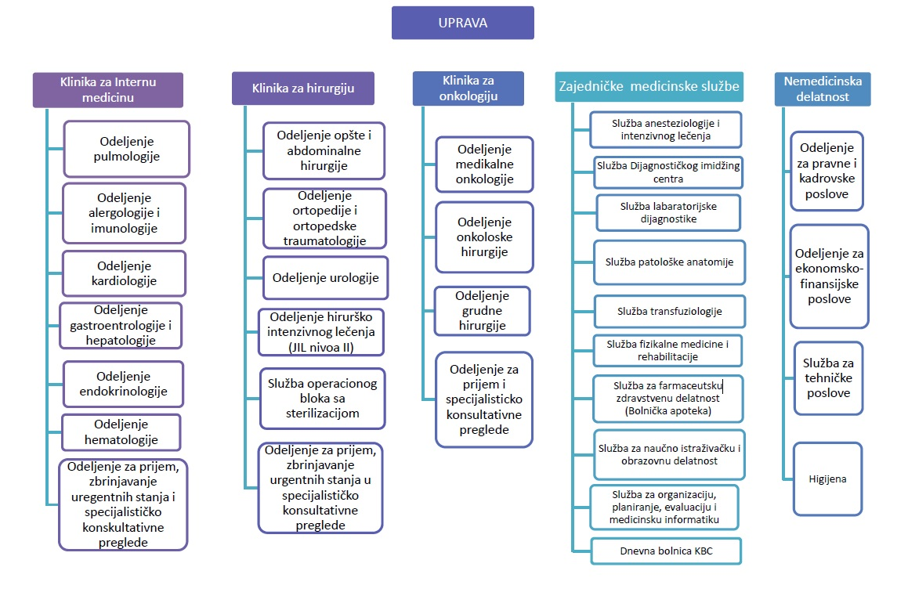
SHEMA TROŠKOVNIH CENTARA
Urgentna stanja
Anesteziologija i intenzivno lečenje

Slide 4
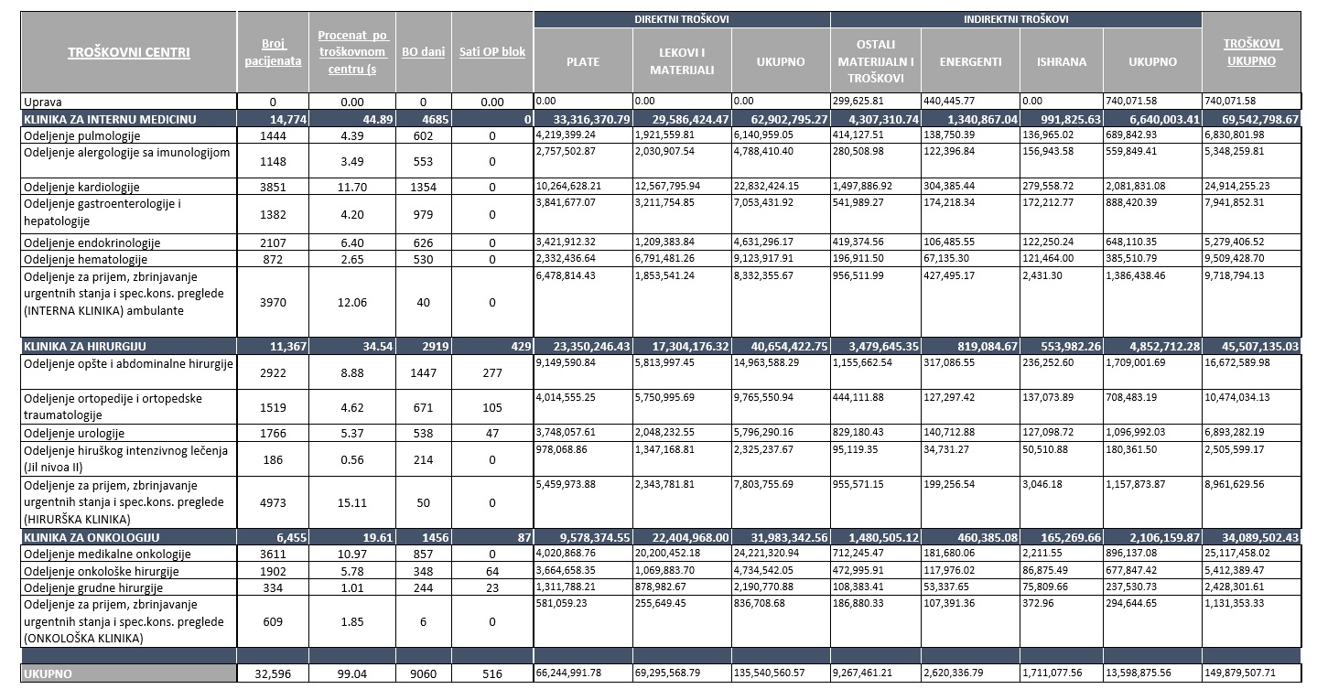
BUDŽET TROŠKOVNIH CENTARA
Finansijska odgovornost načelnika odeljenja
Budžet za lekove i materijal

Slide 5
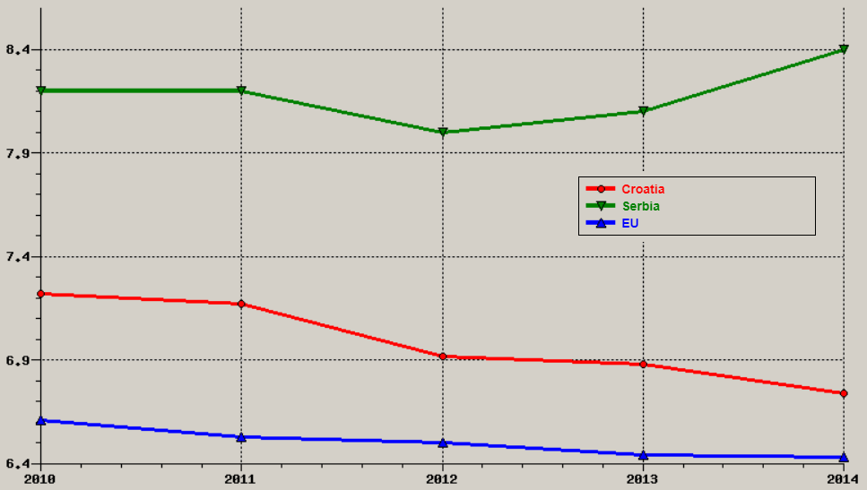
Prosječno trajanje hospitalizacije (samo akutne bolnice)
Source: WHO/Europe, European HFA Database, July 2016.

Slide 6
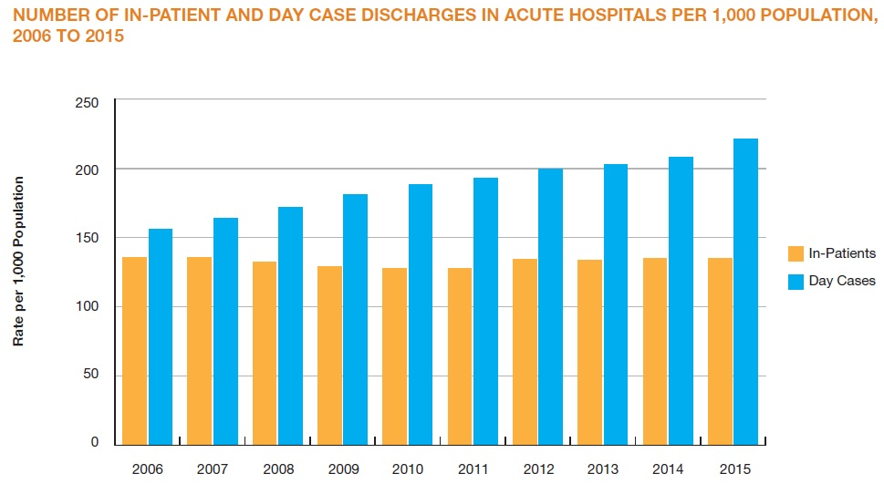
Podaci o bolničkim aktivnostima u Irskoj
 | 2013
In-Patients
In-patient Discharges | 615 211
Bed Days Used | 3 332 974
Average Length of Stay in Days | 5.42
Surgical In-Patients | 134 022
Day Cases
Day Cases | 931 381
Surgical Day Cases | 142 728
Source: http://health.gov.ie/publications-research/statistics/statistics-by-topic/acute-hospital-activity

Slide 7
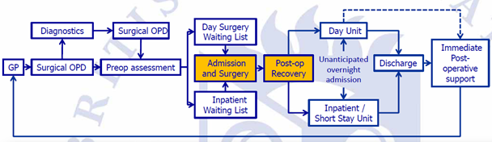
Klinički put dnevne kirurgije
Source: Skues M. BADS Directory of Procedures, 5th Edition. 2016.

Slide 8
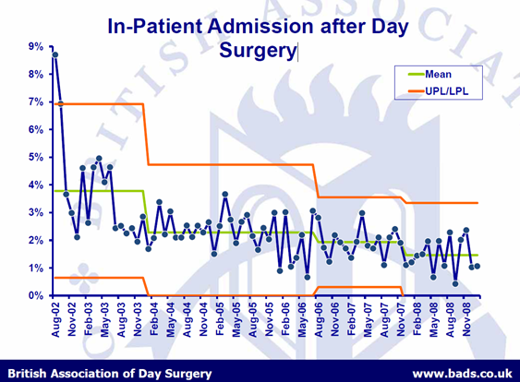

Slide 9
Razlozi za ostanak preko noći
 | Predvidljive | Nepredvidljive
Medicinske | • Komorbiditet | • Komplikacije (kardiovaskularne, respiratorne)
Kirurške | • A challenging individual patient for day care | • Bol • Krvarenje
Anesteziološke | • Broj zaposlenika - vještine | • Postoperativna glavobolja i povraćanje • Somnolencija
Socijalne | • Nedostatak kućne njege
Source: British Association of Day Surgery (BADS)

Slide 10
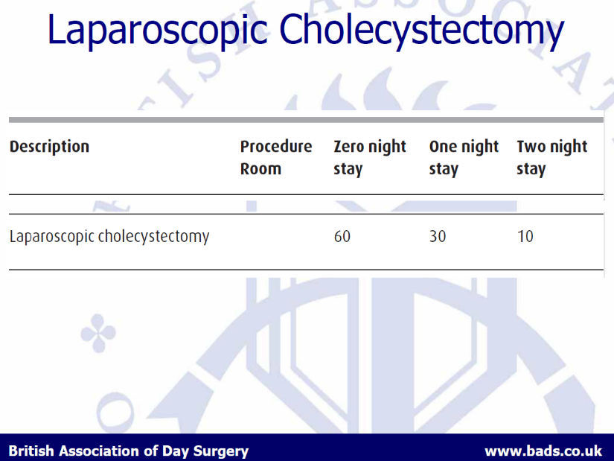
Holecistektomija
Grupa | Naziv | Broj pacijenata | Broj dana (total) | Prosečno trajanje hospitalizacije
H07A | Otvorena holecistektomija sa zatvorenim ispitivanjem prohodnosti ductus choledocus-a ili sa vrlo teškim KK | 5 | 75 | 15,0
H07B | Otvorena holecistektomija bez zatvorenih ispitivanja prohodnosti ductus choledocus-a ili bez vrlo teških KK | 26 | 279 | 10,7
H08A | Laparoskopska holecistektomija sa zatvorenim ispitivanjem prohodnosti ductus choledocus-a ili sa vrlo teškim i teškim KK | 22 | 111 | 5,0
H08B | Laparoskopska holecistektomija bez zatvorenih ispitivanja prohodnosti ductus choledocus-a bez vrlo teških i teških KK | 101 | 345 | 3,4
 | Ukupno | 154 | 810 | 5,3
20,1%

Slide 11
Breast surgery
Grupa | Naziv | Broj pacijenata | Broj dana (total) | Prosečno trajanje hospitalizacije
J07Z | Manje procedure kod bolesti dojke | 106 | 295 | 2,8

Slide 12
Katarakta
Grupa | Naziv | Broj pacijenata | Broj dana (total) | Prosečno trajanje hospitalizacije
C16Z | Procedure na sočivu | 232 | 565 | 2,4
Country | % | Country | %
Australia | 96.6 | Italy | 96.3
Austria | 71.5 | Korea | 91.8
Belgium | 95.4 | Luxembourg | 73.7
Canada | 99.7 | Mexico | 63.8
Czech Republic | 95.2 | New Zealand | 95.6
Denmark | 98.4 | Poland | 30.9
Estonia | 99.2 | Portugal | 95.8
Finland | 98.6 | Slovak Republic | 58.8
France | 88.9 | Slovenia | 97.6
Germany | 81.3 | Spain | 97.9
Hungary | 50.3 | Sweden | 98.2
Ireland | 93.4 | United Kingdom | 98.5
Israel | 92.0 | Lithuania | 41.0
Source: OECD Health Statistics 2017

Slide 13
INTERNATIONAL ASSOCIATION FOR AMBULATORY SURGERY: Day Surgery Procedures
E.N.T Throat: Surgery of adenoids and tonsillectomy Ear Surgery: Procedures with a trans-meatal approach such as placement of grommets or myringoplasty. Even some procedures with a transmastoidal approach are being performed as a day case. Nose: Almost all nasal procedures (endoscopic sinus surgery and nose reconstruction) can be performed on an ambulatory basis. ORAL AND MAXILLOFACIAL SURGERY extraction of carious teeth in children, removal of impacted teeth, surgical exposure of impacted canines, cyst enucleation of large dentigenous cysts, follicular cysts or keratocysts, marsupialisation of mucous retention cysts in the floor of mouth, excision of the sublingual salivary gland, auto-transplantation of premolars and molars, dental implantology | GENERAL SURGERY Hernia surgery. Proctological surgery: 90% of all anal procedures Periproctal abscess incisions Proctological procedures for overnight stay (pain relief and wound control): High fistulas, surgical excision for grade IV haemorrhoids (Eisenhammer operation) Laparoscopic cholecystectomy Thyroid surgery: Hemi-thyroidectomy for nodules with a risk of carcinoma. At least 6 hours of post-operative recovery time is required. OPHTHALMIC SURGERY Cataract surgery Oculoplastic surgery, squint surgery, glaucoma, dacryocystorhinostomia, refractive surgery | BREAST SURGERY Benign lesions: removal of cysts, fibroadenomas, biopsies of palpable/non-palpable lesions, duct excision, correction of gynaecomastia Malignant lesions: operations on day surgery basis for breast cancer are increasing due to the advent of sentinel lymph node biopsy replacing axillary lymph node dissection for primary breast cancer GYNAECOLOGY Diagnostic hysteroscopy, operative hysteroscopy for lesions protruding into the uterine cavity (fibroids), endometrial ablation by hysteroscopy and resectoscope uterine fibroid embolization using angiography, female sterilisation, diagnostic laparoscopy, Hydrolaparoscopy. Operative laparoscopy for ectopic pregnancy, removal of small and benign cysts of the ovary, hysterectomy, myomectomy and prolapse surgery.

Slide 14
INTERNATIONAL ASSOCIATION FOR AMBULATORY SURGERY: Day Surgery Procedures (cont.)
ORTHOPAEDIC SURGERY Knee knee arthroscopy (diagnostic), arthroscopic treatment of minor lesions, arthroscopic removal of osteosynthesis material, arthroscopic anterior cruciate ligament reconstruction Shoulder arthroscopy and examination under general anaesthesia, arthroscopic and mini-open acromioplasty, resection of the lateral part of the clavicle, arthroscopic joint stabilization Elbow arthroscopy and examination under general anaesthesia, arthroscopic treatment of minor lesions, extensor tendon release for treatment of tennis elbow , ulnar nerve transposition, removal of screws and plates and/or cerclages Wrist/hand arthroscopic treatment of minor lesions, carpal tunnel release, arthroplasty of CMC I joint for osteoarthritis, finger joint surgery for rheumatoid arthritis, Dupuytren’s contracture | Foot: hallux valgus surgery, resection arthroplasty or arthrodesis for hammer toe deformities Ankle arthroscopic treatment of minor lesions (e.g. free cartilage bodies, synovial biopsy ligament reconstruction (lateral or syndesmosis) removal of osteosynthesis material Spine removal of osteosynthesis material, microdiscectomy for the treatment of a herniated intervertebral disc Hip removal of osteosynthesis material UROLOGY General urological procedures: Vasectomy, hydrocelectomy, varicocelectomy, vasectomy reversal, circumcision Minimally invasive procedures transurethral resection of bladder tumours, ureteroscopic interventions for ureteric stones, ESWL for stone treatment. | PAEDIATRIC SURGERY inguinal hernia and hydrocoele, umbilical hernia, orchidopexy, circumcision, skin lesions dermoid cysts. PLASTIC SURGERY Wrist/Hand surgery: the same procedures in orthopaedics are performed by plastic surgeons Cosmetic surgery: blepharoplasty , breast augmentation, face lift, abdominoplasty with and without liposuction (with drains to be removed next morning), reconstruction operations (Z-plasty, V-Y plasty) VASCULAR SURGERY varicose veins (surgical, endovenous obliteration by radiofrequency, laser), subfacial endoscopic division (SEPS) for resection of incompetent perforating veins, thoracic sympathectomy (treatment of hyperhidrosis or Raynaud’s disease), endovascular procedures like carotid artery stenting

Slide 15
Potencijalne uštede
Grupa | Naziv | Broj pacijenata | Broj dana (total)
B05Z | Hirurški zahvat na karpalnom tunelu (dekompresija n.medianusa) | 9 | 16
C11Z | Procedure na očnom kapku | 4 | 4
C15A | Glaukom i složene procedure kod katarakte | 5 | 21
C16Z | Procedure na sočivu | 232 | 565
D11Z | Tonzilektomija i/ili adenoidektomija | 160 | 532
D12Z | Ostale procedure na uhu, grlu, nosu i usnoj duplji | 29 | 163
E42A | Bronhoskopija, sa vrlo teškim KK | 10 | 173
E42B | Bronhoskopija, bez vrlo teških KK | 20 | 199
E42C | Bronhoskopija, isti dan | 20 | -
G07B | Apendektomija bez maligniteta ili peritonitisa bez vrlo teških ili teških KK | 70 | 343
G10A | Procedure kod hernije, sa KK | 47 | 251
G10B | Procedure kod hernije, bez KK | 208 | 735
G11Z | Procedure na anusu i stome | 30 | 204
G46A | Složena gastroskopija, sa vrlo teškim KK | 4 | 54
G46B | Složena gastroskopija, bez vrlo teških KK | 27 | 186
G47C | Ostale procedure gastroskopije, istog dana | 4 | -
G48A | Kolonoskopija, sa vrlo teškim ili teškim KK | 3 | 13
G48B | Kolonoskopija, bez vrlo teških ili teških KK | 38 | 226
G48C | Kolonoskopija, istog dana | 73 | -
H07A | Otvorena holecistektomija sa zatvorenim ispitivanjem prohodnosti ductus choledocus-a ili sa vrlo teškim KK | 5 | 75
H07B | Otvorena holecistektomija bez zatvorenih ispitivanja prohodnosti ductus choledocus-a ili bez vrlo teških KK | 26 | 279
H08A | Laparoskopska holecistektomija sa zatvorenim ispitivanjem prohodnosti ductus choledocus-a ili sa vrlo teškim i teškim KK | 22 | 111
H08B | Laparoskopska holecistektomija bez zatvorenih ispitivanja prohodnosti ductus choledocus-a bez vrlo teških i teških KK | 101 | 345
I24Z | Artroskopija | 19 | 137
I25A | Dijagnostičke procedure (uključujući i biopsiju) na kostima i zglobovima, sa KK | 3 | 61
I25B | Dijagnostičke procedure (uključujući i biopsiju) na kostima i zglobovima, bez KK | 12 | 122
I30Z | Procedure na šaci | 68 | 350
J07Z | Manje procedure kod bolesti dojke | 106 | 295
J09Z | Perianalne i pilonidalne procedure | 27 | 71
J10Z | Procedure plastične hirurgije na koži, potkožnom tkivu i dojci | 20 | 106
N07Z | Ostale procedure na materici i adneksama zbog nemalignih uzroka | 138 | 536
N08Z | Endoskopske i laparoskopske procedure na ženskom reproduktivnom sistemu | 4 | 11
N09Z | Konizacija, postupci na vagini, cerviksu (grliću materice) i vulvi (stidnici) | 362 | 754
N10Z | Dijagnostička kiretaža ili dijagnostička histeroskopija | 202 | 169
N11Z | Ostale operativne procedure na ženskom reproduktivnom sistemu | 10 | 50
 | Ukupno | 2.118 | 7.157
141 godina!
60% pacijenata tretirano na dnevnoj osnovi
-51.530 dana
boravka u bolnici

Slide 16

THE FUTURE DEPENDS UPON THE
DECISIONS MADE TODAY
“Will we look into the eyes
of our children and confess
that we had the opportunity,
but lacked the courage?”
"Thank you for your attention“
tihomir.strizrep@gmail.com

